Slide 1
CONCUR PATHS
PRESENTED BY:
SHUBHAM BANSAL
MANSI NIGAM

Slide 2
Concur Paths
OBJECTIVE
The objective of our game Concur Paths is to help the player with the concept of time management by choosing the shortest path for reaching the destination in the given time.
The game is suitable for the students of all grades as it comes with different levels of difficulty from easy to hard.

Slide 3
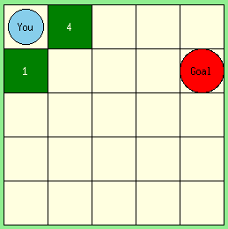
Concur Paths
MECHANICS
Concur paths is a single player game .
The board has a 2D array of paths. The player is represented by blue circle is provided with some points at the beginning of the game.
On the very first index player will start the game and on any random index there will be the destination represented by red circle.
The next possible steps with the value on it will be highlighted on every step. The player has to choose the shortest path in order to reach the destination.
The player can choose any path and the statistics like, total time, points collected by player on reaching the destination and time taken to cover the path, will be shown
If time taken by the player is less than given time, then that level will be completed and 20% points of the total points collected will be awarded to the player.

Slide 4
Concur Paths
OBJECTS
2D array board
Nodes of 2 colours: Light Green for rest of board, Dark Green for possible moves with points written on them.
Timer: Countdown for each level
Paths: Possible movements
Points: Earned by playing game.
Player: Blue circle
Destination : Red circle

Slide 5
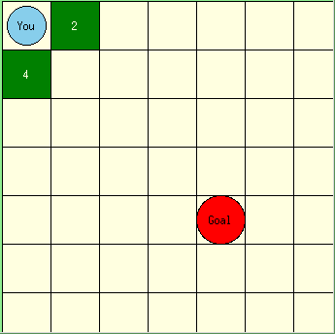
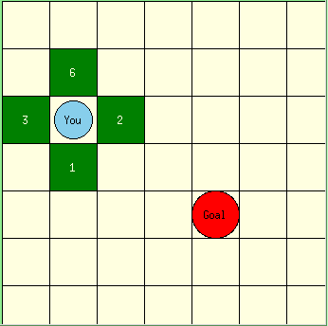
Concur Paths
KEEP ON CHOOSING THE MINIMUM NUMBER TO REACH DESTINATION
Tasks
CHOOSE THE MINIMUM NUMBER
Player
START
Goal
Implementation Plan
Schedules
Customer Objectives
Resources

Slide 6
Concur Paths
TECHNOLOGY USED
Python: Python is a high-level, interpreted, interactive and object-oriented scripting language. Python is designed to be highly readable. It was created by Guido van Rossum during 1985- 1990. It uses English keywords frequently whereas other languages use punctuation, and it has fewer syntactic constructions than other languages.
Tkinter: It is the standard GUI library for Python. Python when combined with Tkinter provides a fast and easy way to create GUI applications. Tkinter provides a powerful object-oriented interface to the Tk GUI toolkit.

Slide 7
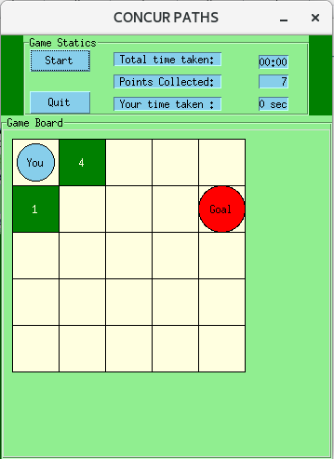
Concur Paths
USER INTERFACE

Slide 8
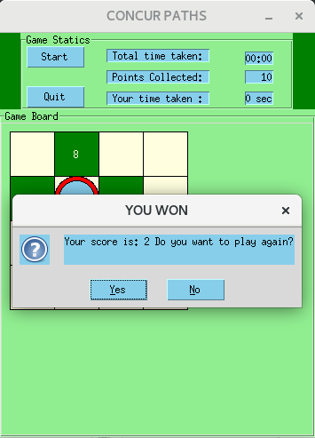

Slide 9
Concur Paths
USES
The game is built by keeping the concept of time management in mind.
Reaching to goal within time to go on next level will excite the player.
Act of choosing the minimum path will let the player learn to choose the best thing in the given time.

Slide 10
Concur Paths
FUTURE SCOPE
Levels of the game can be more complex:
by adding more paths,
by substituting digits with more complex numbers,
Instead of moving one step any type of algorithms can be used to move on.
an algorithm can be made to choose the goal index,
3d boards can be made,
3d board can have more complex paths,
Ads and in- app purchases can be added in order to make player earn points for playing the game.

Slide 11
Thank You

